Slide 1
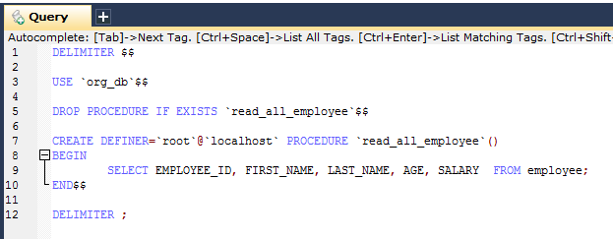
Returning ResultSet/REF Cursor from a SimpleJdbcCall
Stored procedure that takes no IN parameters and returns all rows from the employee table

Slide 2
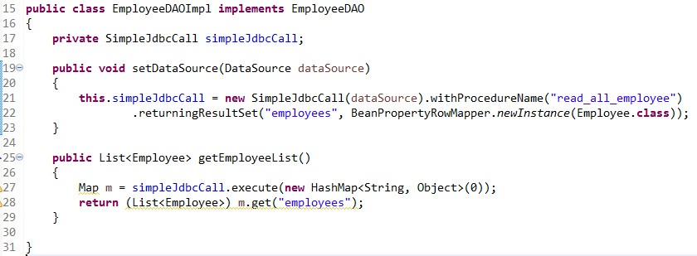
Returning ResultSet/REF Cursor from a SimpleJdbcCall
Calling a stored procedure or function that returns a result set is a bit tricky. Some databases return result sets during the JDBC results processing while others require an explicitly registered out parameter of a specific type. Both approaches need additional processing to loop over the result set and process the returned rows. With the SimpleJdbcCall you use the returningResultSet method and declare a RowMapper implementation to be used for a specific parameter. In the case where the result set is returned during the results processing, there are no names defined, so the returned results will have to match the order in which you declare the RowMapper implementations. The name specified is still used to store the processed list of results in the results map that is returned from the execute statement.
To call this procedure you declare the RowMapper. Because the class you want to map to follows the JavaBean rules, you can use a BeanPropertyRowMapper that is created by passing in the required class to map to in the newInstance method.
The execute call passes in an empty Map because this call does not take any parameters. The list of Employee is then retrieved from the results map and returned to the caller.

